Slide 1
Thinking Like an Economist
CHAPTER 2
Notes:
N. Gregory Mankiw Principles Of Economics Eight Edition

Slide 2
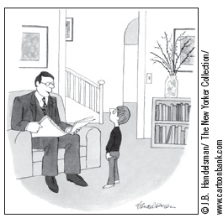
The Economist as a Scientist, Part 1
Economics is a science
Economists are scientists
Devise theories
Collect data
Analyze these data
Verify or refute their theories
Use the scientific method
“I’m a social scientist, Michael. That means I can’t explain electricity or anything like that, but if you ever want to know about people, I’m your man.”

Slide 3
The Economist as a Scientist, Part 2
Scientific method
Dispassionate development and testing of theories about how the world works
Observation, theory, more observation
Conducting experiments in economics
Is often impractical
Substitute for laboratory experiments
Economists pay close attention to the natural experiments offered by history

Slide 4
The Economist as a Scientist, Part 3
The role of assumptions
Assumptions
Can simplify the complex world and make it easier to understand
The art in scientific thinking: deciding which assumptions to make
Different assumptions
To answer different questions
To study short-run or long-run effects

Slide 5
The Economist as a Scientist, Part 4
Economic models
Diagrams and equations
Omit many details
Allow us to see what’s truly important
Built with assumptions
Simplify reality to improve our understanding of it

Slide 6
The Economist as a Scientist, Part 5
Circular-flow diagram
Visual model of the economy
Shows how dollars flow through markets among households and firms
Two decision makers
Firms and Households
Two markets
For goods and services
For factors of production (inputs)

Slide 7
The Economist as a Scientist, Part 6
Firms
Produce goods and services
Use factors of production (inputs)
Households
Own factors of production
Consume goods and services

Slide 8
The Economist as a Scientist, Part 7
Firms and Households interact in markets
Markets for goods and services
Firms are sellers
Households are buyers
Markets for factors of production
Firms are buyers
Households are sellers

Slide 9
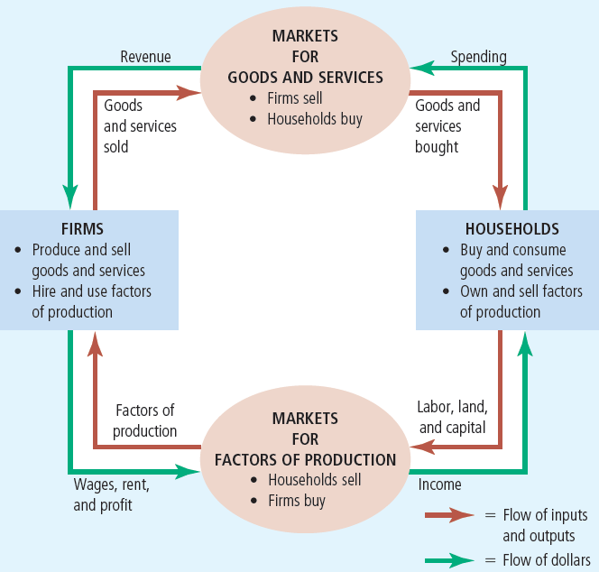
Figure 1 The circular flow
This diagram is a schematic representation of the organization of the economy.
Decisions are made by households and firms.
Households and firms interact in the markets for goods and services (where households are buyers and firms are sellers) and in the markets for the factors of production (where firms are buyers and households are sellers).
The outer set of arrows shows the flow of dollars, and the inner set of arrows shows the corresponding flow of inputs and outputs.

Slide 10
The Economist as a Scientist, Part 8
Production possibilities frontier
A graph
Combinations of output that the economy can possibly produce
Given the available
Factors of production
Production technology

Slide 11
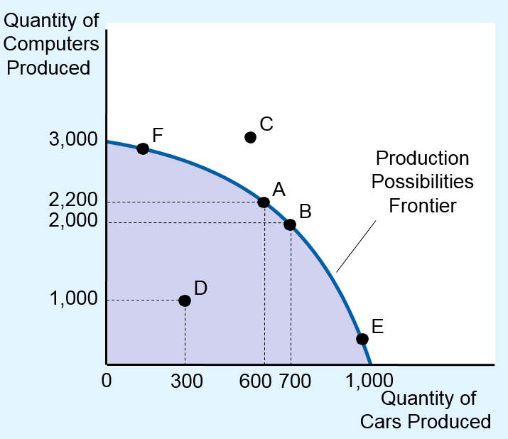
Figure 2 The production possibilities frontier
The production possibilities frontier shows the combinations of output—in this case, cars and computers—that the economy can possibly produce.
The economy can produce any combination on or inside the frontier.
Points outside the frontier are not feasible given the economy’s resources.
The slope of the production possibilities frontier measures the opportunity cost of a car in terms of computers. This opportunity cost varies, depending on how much of the two goods the economy is producing.

Slide 12
The Economist as a Scientist, Part 9
Efficient levels of production
The economy is getting all it can from the scarce resources available
Points on the production possibilities frontier
Trade-off:
The only way to produce more of one good is to produce less of the other good
Moving from point A to point B: give up 200 computers to produce 100 more cars

Slide 13
The Economist as a Scientist, Part 10
Inefficient levels of production
Points inside production possibilities frontier
Opportunity cost of producing one good
Give up producing units of the other good
Slope of the production possibilities frontier

Slide 14
The Economist as a Scientist, Part 11
Bowed outward production possibilities frontier
Opportunity cost of a car is highest
When the economy is producing many cars and fewer computers
Opportunity cost of a car is lower
When the economy is producing fewer cars and many computers
Resource specialization

Slide 15
The Economist as a Scientist, Part 12
Technological advance
Outward shift of the production possibilities frontier
Economic growth
Produce more of both goods

Slide 16
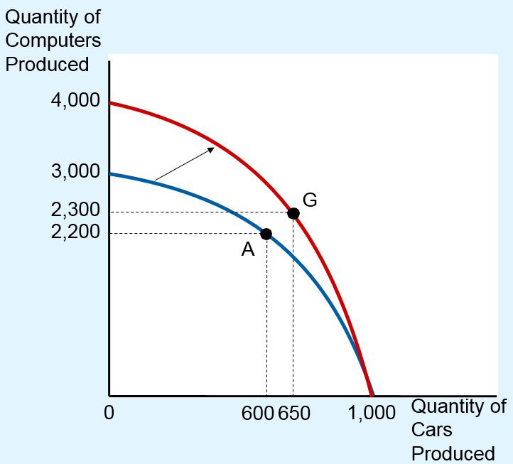
Figure 3 A shift in the production possibilities frontier
A technological advance in the computer industry enables the economy to produce more computers for any given number of cars.
As a result, the production possibilities frontier shifts outward.
If the economy moves from point A to point G, then the production of both cars and computers increases.

Slide 17
The Economist as a Scientist, Part 13
Microeconomics
The study of how households and firms make decisions and how they interact in markets
Macroeconomics
The study of economy-wide phenomena, including inflation, unemployment, and economic growth

Slide 18
The Economist as Policy Adviser, Part 1
Positive statements: descriptive
Attempt to describe the world as it is
Confirm or refute by examining evidence: “Minimum-wage laws cause unemployment”
Normative statements: prescriptive
Attempt to prescribe how the world should be: “The government should raise the minimum wage”

Slide 19
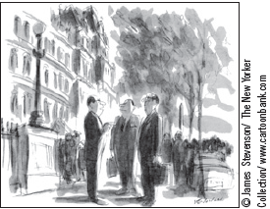
The Economist as Policy Adviser, Part 2
Economists in Washington
Council of Economic Advisers
Advise the president of the United States
Annual Economic Report of the President: discusses recent developments in the economy and presents the council’s analysis of current policy issues
“Let’s switch. I’ll make the policy, you implement it, and he’ll explain it.”

Slide 20
The Economist as Policy Adviser, Part 3
Economists in Washington
Office of Management and Budget
Department of the Treasury
Department of Labor
Department of Justice
Congressional Budget Office
The Federal Reserve

Slide 21
The Economist as Policy Adviser, Part 4
Economists’ advice is not always followed
Economic advisers: what policy is best
Communication advisers: how best to explain it to the public
Press advisers: how the news media will report
Legislative affairs advisers: how Congress will view the proposal
Political advisers: effect on the electorate
The president: decision

Slide 22
Why Economists Disagree, Part 1
Economists may disagree
Validity of alternative positive theories about how the world works
Economists may have different values
Different normative views about what policy should try to accomplish

Slide 23
Why Economists Disagree, Part 2
Differences in scientific judgments
Different hunches about
Validity of alternative theories
Size of important parameters
Measure how economic variables are related

Slide 24
Why Economists Disagree, Part 3
Differences in values
Peter and Paula – take the same amount of water from the town well
Peter’s income = $100,000
Tax = $10,000 (10%)
Paula’s income = $20,000
Tax = $4,000 (20%)

Slide 25
Why Economists Disagree, Part 4
Perception versus Reality
Rent control
Adversely affects availability and quality of housing
Costly way of helping the neediest members of society
Many cities use rent control
Trade barriers (tariffs and import quotas)
Economists oppose it

Slide 26
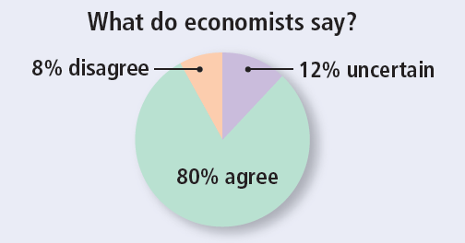
ASK THE EXPERTS
Ticket Resale
“Laws that limit the resale of tickets for entertainment and sports events make potential audience members for those events worse off on average.”
Notes:
Source: IGM Economic Experts Panel, April 16, 2012.

Slide 27
Table 1 Propositions about Which Most Economists Agree, Part 1
Proposition (and percentage of economists who agree)
A ceiling on rents reduces the quantity and quality of housing available. (93%)
Tariffs and import quotas usually reduce general economic welfare. (93%)
Flexible and floating exchange rates offer an effective international monetary arrangement. (90%)
Fiscal policy (for example, tax cut and/or government expenditure increase) has a significant stimulative impact on a less than fully employed economy. (90%)
The United States should not restrict employers from outsourcing work to foreign countries. (90%)
Economic growth in developed countries like the United States leads to greater levels of well-being. (88%)
The United States should eliminate agricultural subsidies. (85%)
An appropriately designed fiscal policy can increase the long-run rate of capital formation. (85%)
Local and state governments should eliminate subsidies to professional sports franchises. (85%)
If the federal budget is to be balanced, it should be done over the business cycle rather than yearly. (85%)

Slide 28
Table 1 Propositions about Which Most Economists Agree, Part 2
The gap between Social Security funds and expenditures will become unsustainably large within the next 50 years if current policies remain unchanged. (85%)
Cash payments increase the welfare of recipients to a greater degree than do transfers-in kind of equal cash value. (84%)
A large federal budget deficit has an adverse effect on the economy. (83%)
The redistribution of income in the United States is a legitimate role for the government.(83%)
Inflation is caused primarily by too much growth in the money supply. (83%)
The United States should not ban genetically modified crops. (82%)
A minimum wage increases unemployment among young and unskilled workers. (79%)
The government should restructure the welfare system along the lines of a “negative income tax.” (79%)
Effluent taxes and marketable pollution permits represent a better approach to pollution control than the imposition of pollution ceilings. (78%)
Government subsidies on ethanol in the United States should be reduced or eliminated. (78%)

Slide 29

Graphing: A Brief Review, Part 1
Graphs serve two purposes:
Visually express ideas that might be less clear if described with equations or words
Powerful way of finding and interpreting patterns
Graphs of a single variable
Pie chart
Bar graph
Time-series graph

Slide 30
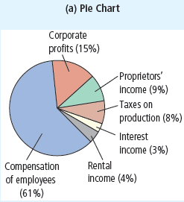
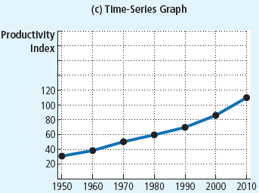
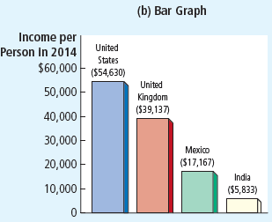
Figure A-1 Types of Graphs
The pie chart in panel (a) shows how U.S. national income is derived from various sources.
The bar graph in panel (b) compares the average income in four countries.
The time-series graph in panel (c) shows the productivity of labor in U.S. businesses over time.

Slide 31
Graphing: A Brief Review, Part 2
Graphs of two variables: the coordinate system
Display two variables on a single graph
Scatterplot
Ordered pairs of points
x-coordinate
Horizontal location
y-coordinate
Vertical location

Slide 32
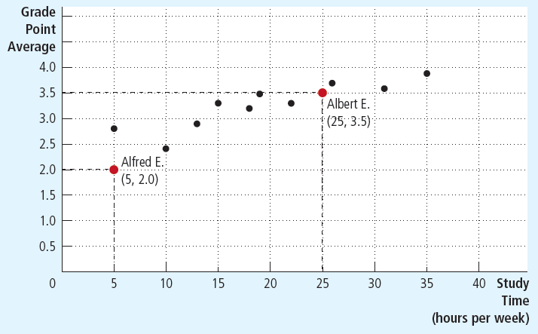
Figure A-2 Using the Coordinate System
Grade point average is measured on the vertical axis and study time on the horizontal axis.
Albert E., Alfred E., and their classmates are represented by various points.
We can see from the graph that students who study more tend to get higher grades.

Slide 33
Graphing: A Brief Review, Part 3
Curves in the coordinate system
Data
Number of novels purchased
Price of novels and Income
Demand curve
Effect of a good’s price
On the quantity of the good consumers want to buy
For a given income

Slide 34
Table A-1 Novels Purchased by Emma
Price | For $30,000 Income: | For $40,000 Income: | For $50,000 Income:
$10 | 2 novels | 5 novels | 8 novels
9 | 6 | 9 | 12
8 | 10 | 13 | 16
7 | 14 | 17 | 20
6 | 18 | 21 | 24
5 | 22 | 25 | 28
 | Demand curve, D₃ | Demand curve, D₁ | Demand curve, D₂
This table shows the number of novels Emma buys at various incomes and prices.
For any given level of income, the data on price and quantity demanded can be graphed to produce Emma’s demand curve for novels, as shown in Figures A-3 and A-4.

Slide 35
Graphing: A Brief Review, Part 4
Negatively related variables
The two variables move in opposite direction
Downward sloping curve
Positively related variables
The two variables move in the same direction
Upward sloping curve
Movement along a curve
Shifts in a curve

Slide 36
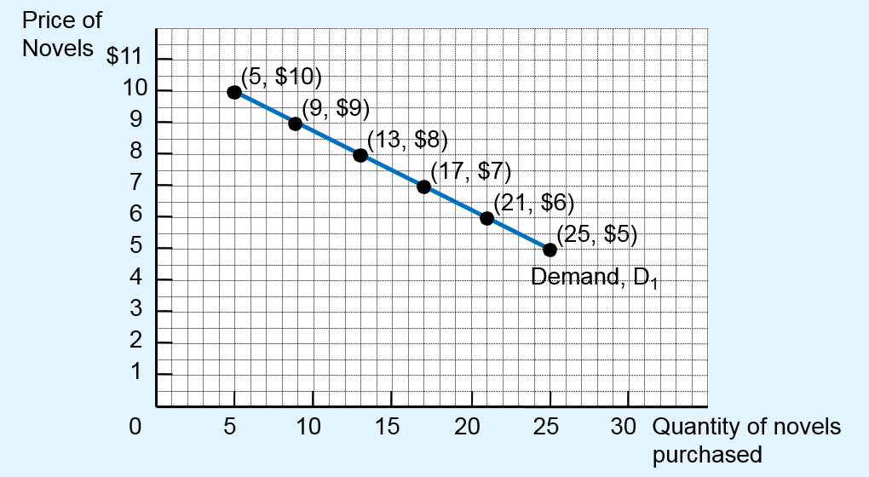
Figure A-3 Demand Curve
The line D₁ shows how Emma’s purchases of novels depend on the price of novels when her income is held constant. Because the price and the quantity demanded are negatively related, the demand curve slopes downward.

Slide 37
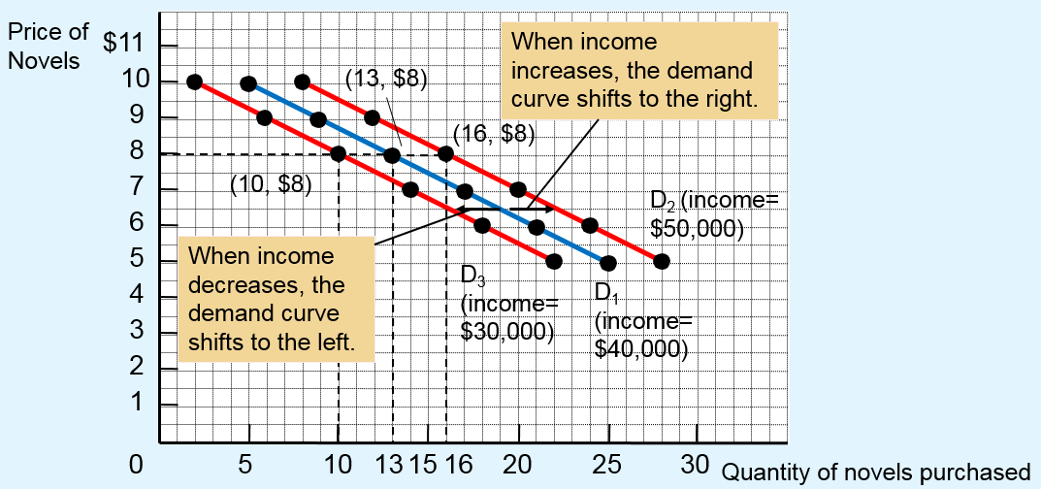
Figure A-4 Shifting Demand Curves
The location of Emma’s demand curve for novels depends on how much income she earns. The more she earns, the more novels she will purchase at any given price, and the farther to the right her demand curve will lie. Curve D₁ represents Emma’s original demand curve when her income is $40,000 per year.
If her income rises to $50,000 per year, her demand curve shifts to D₂.
If her income falls to $30,000 per year, her demand curve shifts to D₃.

Slide 38
Graphing: A Brief Review, Part 5
Slope
Ratio of the vertical distance covered
To the horizontal distance covered
As we move along the line
Δ (delta) = change in a variable
The “rise” (change in y) divided by the “run” (change in x).

Slide 39
Graphing: A Brief Review, Part 6
Slope
Fairly flat upward-sloping line
Slope is a small positive number
Steep upward-sloping line
Slope is a large positive number
Downward sloping line
Slope is a negative number
Horizontal line: slope is zero
Vertical line: infinite slope

Slide 40
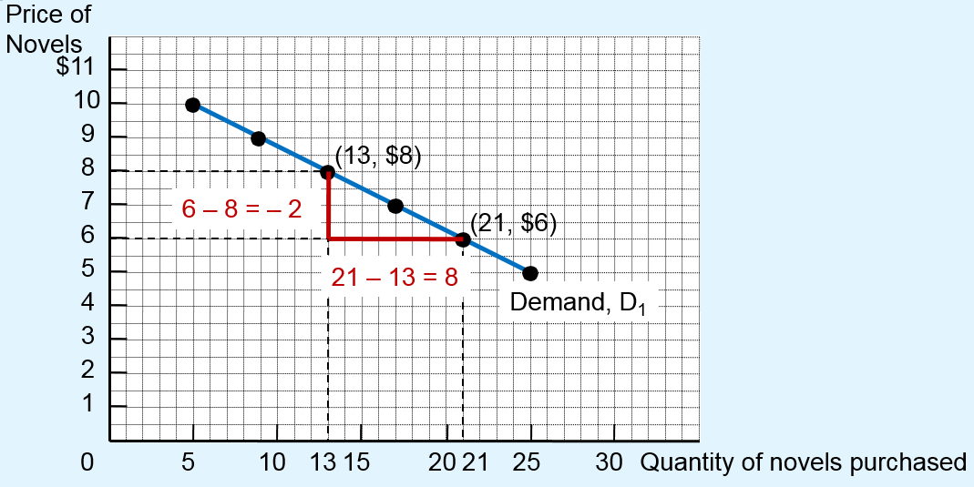
Figure A-5 Calculating the Slope of a Line
To calculate the slope of the demand curve, we can look at the changes in the x- and y-coordinates as we move from the point (21 novels, $6) to the point (13 novels, $8). The slope of the line is the ratio of the change in the y-coordinate (–2) to the change in the x-coordinate (+8), which equals –1⁄4.

Slide 41
Graphing: A Brief Review, Part 7
Cause and effect
One set of events
Causes another set of events
Omitted variables
Lead to a deceptive graph

Slide 42
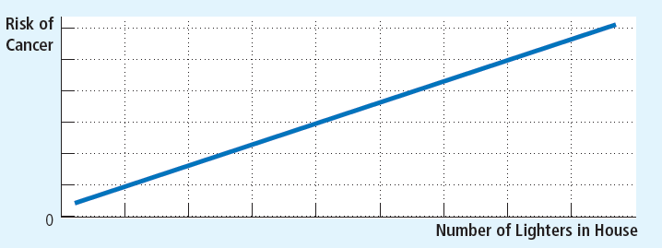
Figure A-6 Graph with an Omitted Variable
The upward-sloping curve shows that members of households with more cigarette lighters are more likely to develop cancer. Yet we should not conclude that ownership of lighters causes cancer because the graph does not take into account the number of cigarettes smoked.

Slide 43
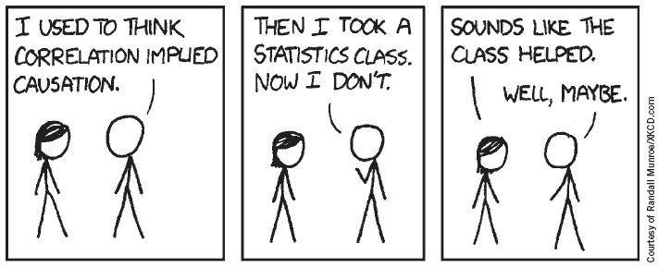
Graphing: A Brief Review
Cause and effect
Reverse causality
Decide that event A causes event B
Facts: event B causes event A

Slide 44
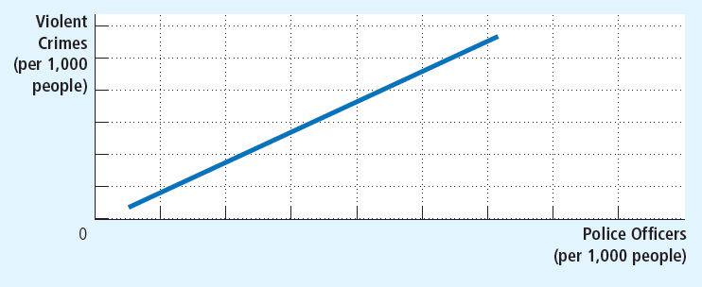
Figure A-7 Graph Suggesting Reverse Causality
The upward-sloping curve shows that cities with a higher concentration of police are more dangerous. Yet the graph does not tell us whether police cause crime or crime-plagued cities hire more police.

